Slide 1
DeepFittingRoom: A deep learning framework that helps you try different clothes at home
Michael Xu, Ziqi Pei,
Liyang Zhao, Jiazhong Mei, Ziyang Zhou
UC Berkeley, Mar. 2019

Slide 2
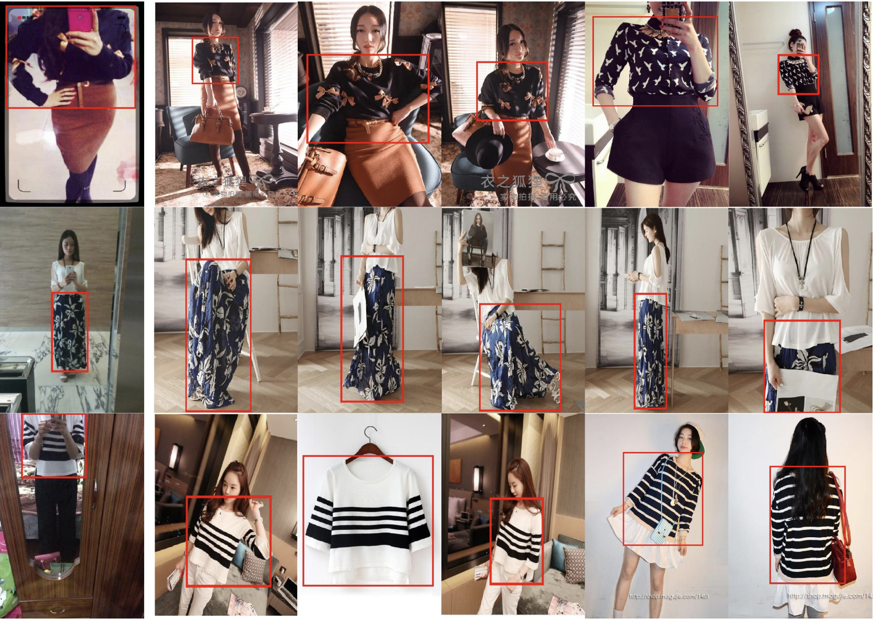
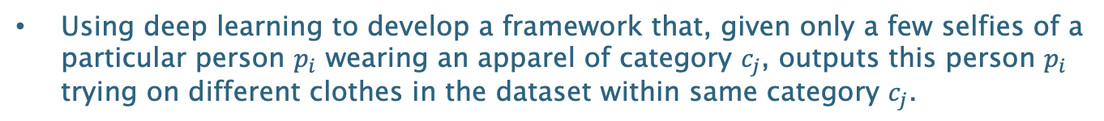
Objective:
Using deep learning to develop a framework that, given only a few selfies of a particular person $p_{i}$ wearing an apparel of category $c_{j}$, outputs this person $p_{i}$ trying on different clothes in the dataset within same category $c_{j}$.
Dataset:
DeepFashion & DeepFashion 2
Category id, scale, occlusion, bounding box, viewpoint
Preprocessing: clothes extraction, reposition(Kabsch Algo), etc.

Slide 3
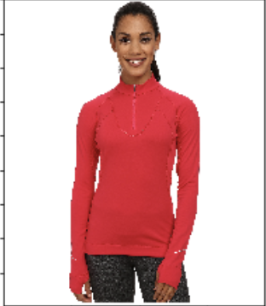
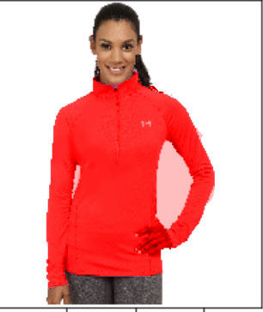
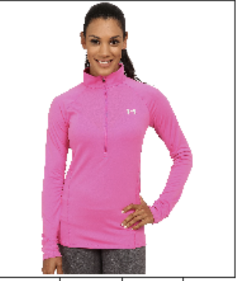
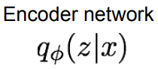
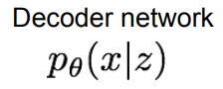

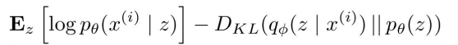
Clothes-Swap Algorithm (Autoencoder)
Encoder
DecoderA
NOISE
Encoder
DecoderA
Encoder
DecoderB
NOISE
Loss: Make posterior distribution close to prior, Maximize likelihood of original input being reconstructed
Core Issues
Each decoder is clothes-specific (expensive training cost)
Required training data for each decoder is insufficient
Limitations on different categories
Potential Solutions / Improvements
Start developing each decoder from trained networks with the clothes with most shared characteristics
Combine a category-specific decoder with a clothes-specific decoder to prevent underfitting
Utilize the state-of-the-art GANs to improve stability and quality

